Slide 1
Predicting NFL Outcomes
Nate Cull, Caspar Hu, Liam Kincaid, Ben Reutelshofer, and Kathleen Roe
Notes:
Hi everyone thanks for coming out this afternoon
We all have a combined interest in the NFL and wanted to focus our project around this

Slide 2
Problem
How can we predict NFL game outcomes Home vs. Away using data from past seasons?
Notes:
Overall problem: how can we predict game outcomes using historical data from past seasons
Relevance: betting industry
Continued growth and popularity of sports betting = more people trying to predict models
Struggle = consistently predicting outcomes
We wanted to take a stab at it

Slide 3
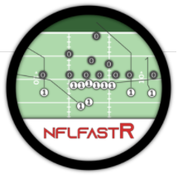
Overview of Data
Initial Analysis & Clustering:
Play by play data (2019-2020)
XGBoost
Game results data (2011-2020)
Response variable: score differential
Notes:
First: used EPA values to analyze play by play data
Second: new data set = game results
Created our own var: score differential
2011-2018 = train AND 2019-2020 = test
But again: a lot of our initial analyses built off of epa values which Ben is going to describe next...

Slide 4
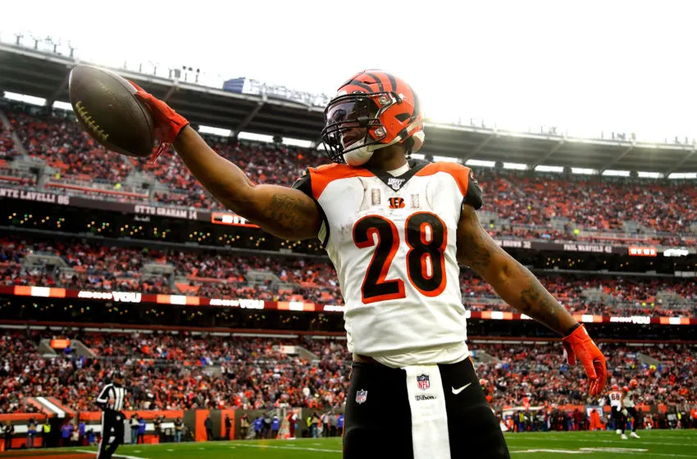
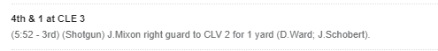
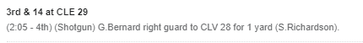
Variables of Importance
Expected Points Added (EPA):
Account for game situation, down/distance
Eliminate counting stats from analysis
EPA: 2.339
EPA: -0.093

Slide 5
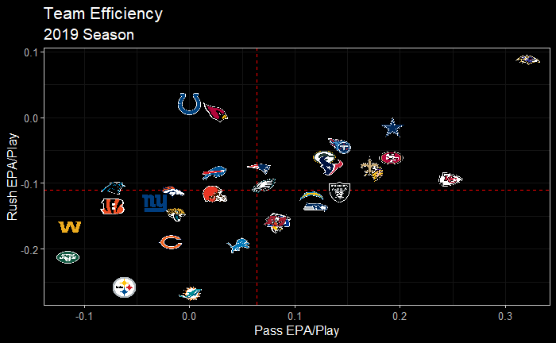
Initial Exploration
Better Rushing Efficiency
Better Passing Efficiency

Slide 6
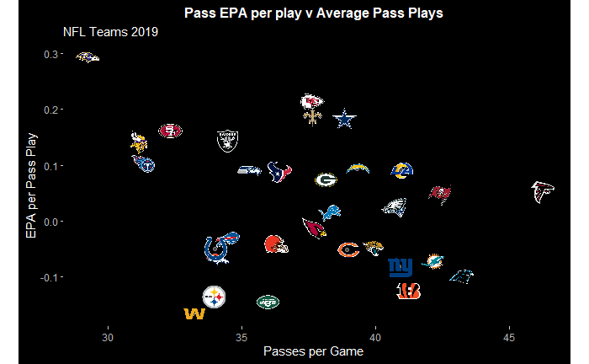
More Exploration
Ultra-efficient, despite low number of attempts/game

Slide 7
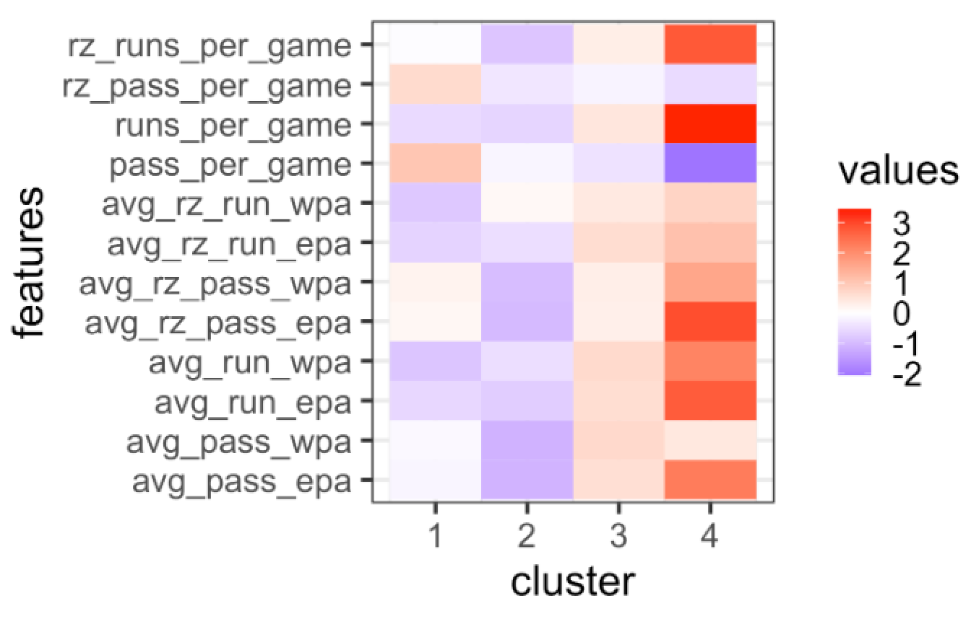
Clustering
Teams
Cluster 1: ATL, CAR, DET, JAX, LA, LAC, MIA, NE, TB
Cluster 2: CHI, CIN, CLE, DEN, NYG, NYJ, PIT, WAS
Cluster 3: ARI, BUF, DAL,
GB, HOU, IND, KC, MIN, NO, OAK, PHI, SEA, SF, TEN
Cluster 4: BAL

Slide 8
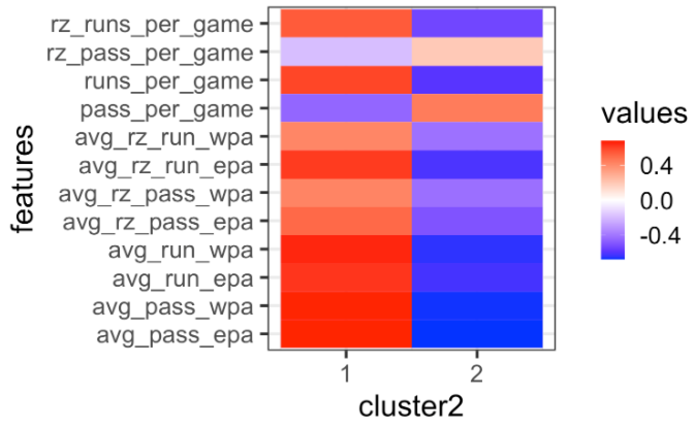
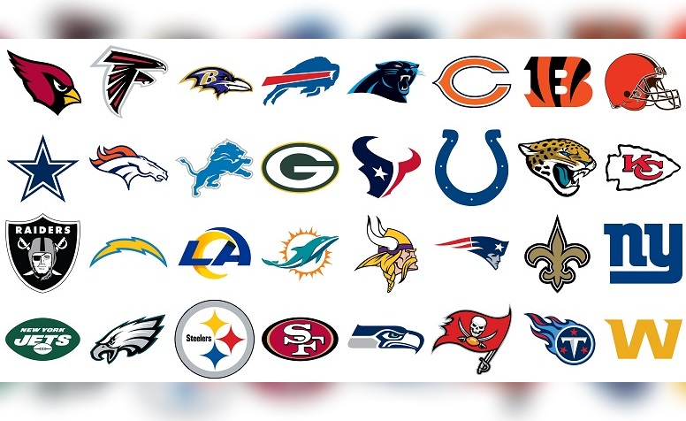
Clustering
Teams
Cluster 1

Slide 9
Clustering
Teams
Cluster 2

Slide 10
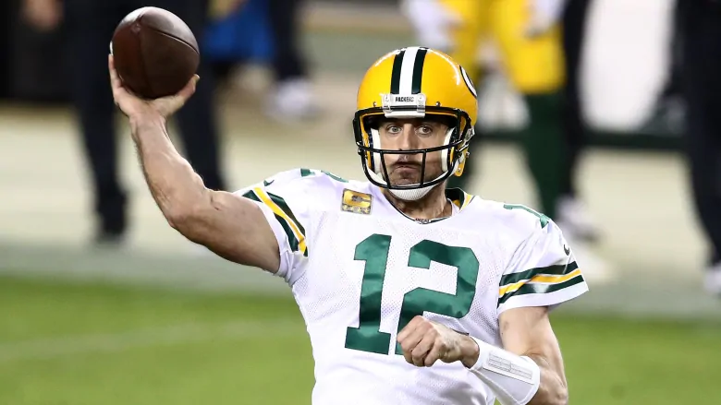
Why XG Boost?
Used for regression and classification
Stronger prediction power than other types of models (bagging, random forests, decision trees)
Resilient to overfitting
Best fit for the dataset and the target objective of our analysis

Slide 11
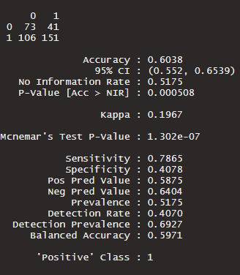
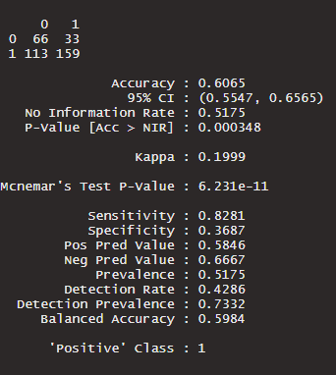
Findings
Naive Model
Final Model

Slide 12
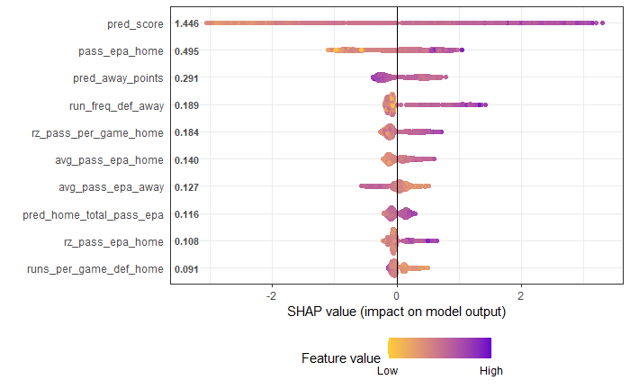
Findings
High Feature Value
Positive Impact
Negative Impact

Slide 13

Insights
EPA and WPA statistics have a strong impact on the outcomes of NFL games
For Vegas and Sports Bettors:
Focus should be placed on a team’s passing offense above all other factors when making picks
With a 60% accuracy rate, bettors could use this model to see a positive return on their investments
While certain insights can be made, overall, predicting NFL games is a challenging task

Slide 14
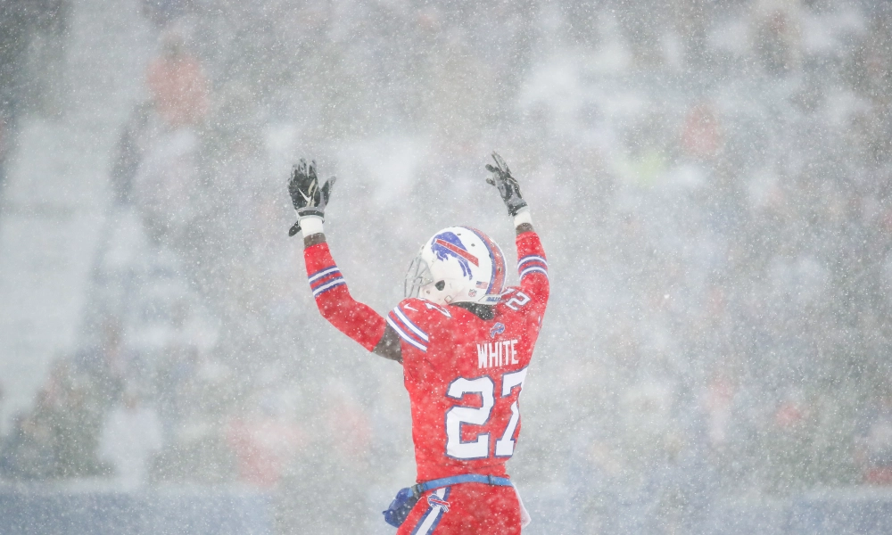
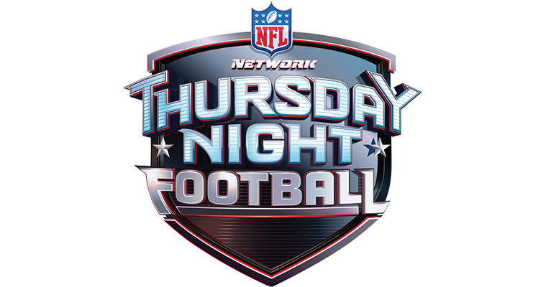
Model Improvements
Account for:
Weather
Travel
Coaching
Injuries
Days Since Last Game

Slide 15
Thank you!
Questions?

